Slide 1
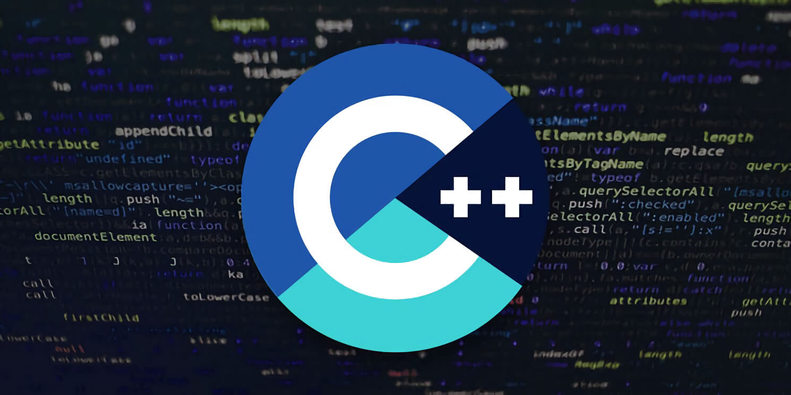
Series 2

Slide 2

Learn Professional C++ | Essentials
Block.Hub Academy

Slide 3
About the Instructor
Block.Hub Academy

Slide 4

Experience
Android – Dec 2015 to Mar 2017
Blockchain – Apr 2017 to till date
Data Science – Dec 2018 to till date
Chatbots (Telegram mostly) – Aug 2019 to till date
Language Proficiency – Python, C++, Java, etc…
Block.Hub Academy

Slide 5
Course Curriculum
Block.Hub Academy

Slide 6
Course Outline
Section 1 – Beginner level
Introduction [30 mins]
Bits & Bytes [1 hrs]
Loops & Decisions [2 hrs]
Functions | Lambdas [2 hrs]
Enums | define | const [2 hrs]
Block.Hub Academy

Slide 7
Course Outline (Cont…)
Section 2 – Intermediate Level
Structures [3 hrs]
Classes & Objects [5 hrs]
Arrays & Strings [2 hrs]
Operator Overloading [3 hrs]
Block.Hub Academy

Slide 8
Course Outline (Cont…)
Section 3 – Advanced Level
Inheritance [2 hrs]
Pointers [2 hrs]
Virtual Functions [3 hrs]
Streams & Files [2 hrs]
Block.Hub Academy

Slide 9
Course Outline (Cont…)
Section 4 – Pro Level
Multifile Programs [2 hrs]
Templates & Exceptions [2 hrs]
STL [4 hrs]
Block.Hub Academy

Slide 10
Software Tools
Block.Hub Academy

Slide 11
Tools
Editor ---- Sublime Text 3 (with linting enabled)
Compiler ---- GCC (in bash terminal [ubuntu])
Block.Hub Academy

Slide 12
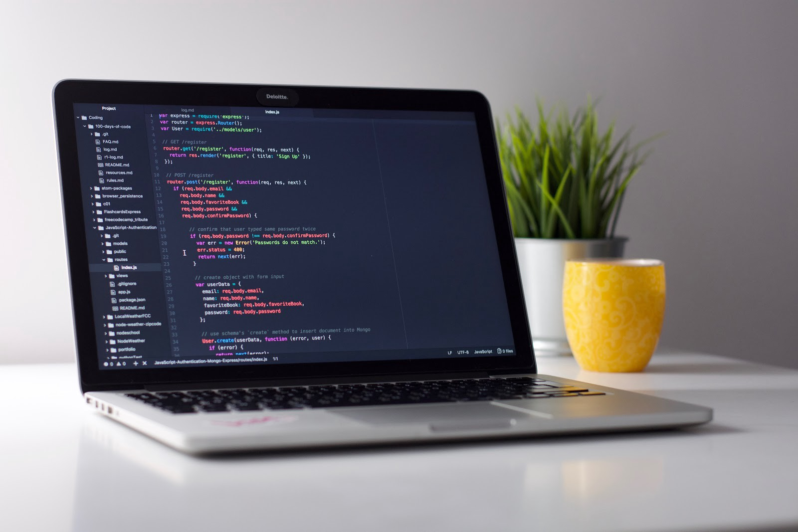
Happy Coding! ☺
Block.Hub Academy
Follow Block.Hub Academy on:
Udemy
Medium
Twitter
Github
Facebook
YouTube
Telegram

